Slide 1

Hands-on supervised machine learning
March 16 2016, Shangri La, New Delhi
Aspiring Minds
research.aspiringminds.com
Notes:
Change title and authors

Slide 2
You will do…
March 16 2016, Shangri La, New Delhi
Start with a data set where we want to do a prediction
Sanitize the data
Visualize it
Make a model and learn how to evaluate the model

Slide 3
Setup
March 16 2016, Shangri La, New Delhi
Go to resource folder at:
researchapi.aspiringminds.in/AMDB/
Go to tmpnb.org
Upload codebook.ipynb and ameo_15.csv
Notes:
Change title and authors

Slide 4
Session 1
March 16 2016, Shangri La, New Delhi
Knowing your dataset
Notes:
Change title and authors

Slide 5
March 16 2016, Shangri La, New Delhi
Known Inputs
Unseen Inputs
1
Build an ML predictor
3
2
Expected output
Predicted output
Notes:
Change title and authors

Slide 6
March 16 2016, Shangri La, New Delhi
Open the excel and take a quick look
Notes:
Change title and authors

Slide 7
March 16 2016, Shangri La, New Delhi
Salary | DOJ | DOL | Designation | JobCity | Gender | DOB | 10percentage | 10board
Notes:
Change title and authors

Slide 8
March 16 2016, Shangri La, New Delhi
Expected output
Salary | DOJ | DOL | Designation | JobCity | Gender | DOB | 10percentage | 10board
Notes:
Change title and authors

Slide 9
March 16 2016, Shangri La, New Delhi
Known inputs
Salary | DOJ | DOL | Designation | JobCity | Gender | DOB | 10percentage | 10board
Notes:
Change title and authors

Slide 10
March 16 2016, Shangri La, New Delhi
Getting started
Importing in python
Validating the imported data in python
Notes:
Change title and authors

Slide 11
March 16 2016, Shangri La, New Delhi
Should we get started with training a model?
Known Inputs
1
Build an ML predictor
Expected output
Notes:
Change title and authors

Slide 12
March 16 2016, Shangri La, New Delhi
Should we get started with training a model?
Known Inputs
NO!
Inspect and visualize
Clean
1
Build an ML predictor
Expected output
Notes:
Change title and authors

Slide 13

March 16 2016, Shangri La, New Delhi
Inspecting your data
Critical step
Gives you an idea of the monster you are trying to tame.
Makes you realize inconsistencies in the data you are dealing with
Notes:
Change title and authors

Slide 14
March 16 2016, Shangri La, New Delhi
Knowing your data
Basic data statistics
Continuous valued variables
Mean
Median
Standard deviation
Percentile points
Notes:
Change title and authors

Slide 15
March 16 2016, Shangri La, New Delhi
Knowing your data
CHECKPOINT #2
Notes:
Change title and authors

Slide 16

March 16 2016, Shangri La, New Delhi
Inspecting further
Critical step
Fix inconsistencies
Different data types in the same feature
Missing values
Making values homogenous
Notes:
Change title and authors

Slide 17
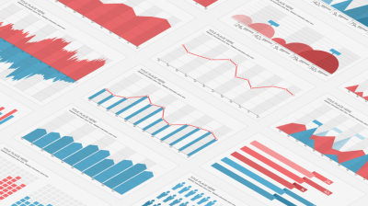
March 16 2016, Shangri La, New Delhi
Visualize
Output
Inputs
Inputs vs Outputs
Notes:
Change title and authors

Slide 18
March 16 2016, Shangri La, New Delhi
Visualize
Descriptive Statistics
Mean, Median, Std, Percentile points
Continuous variables
Histograms
Categorical variables
Bar charts
Input vs. Output
Scatter plots
Box plots
Notes:
Change title and authors

Slide 19
March 16 2016, Shangri La, New Delhi
Inspecting further
CHECKPOINT #3
Notes:
Change title and authors

Slide 20
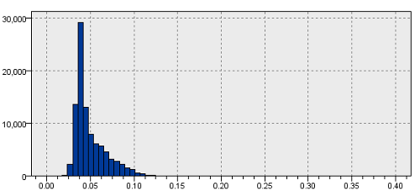
March 16 2016, Shangri La, New Delhi
What can one expect to see?
Class imbalance in the output
Notes:
Change title and authors
MAY BE SPLIT IN TWO SLIDES… WANT TO SPEND TIME HERE

Slide 21
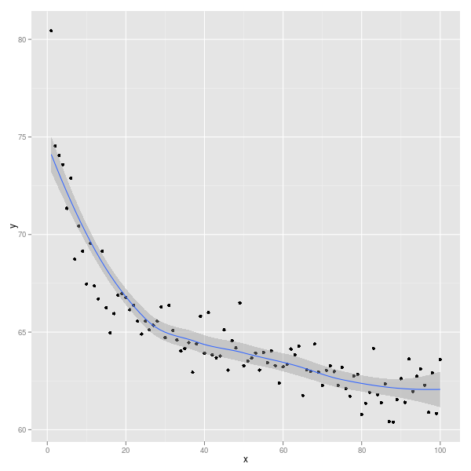
March 16 2016, Shangri La, New Delhi
What can one expect to see?
Specific relation b/w inputs and output
Notes:
Change title and authors
MAY BE SPLIT IN TWO SLIDES… WANT TO SPEND TIME HERE

Slide 22
March 16 2016, Shangri La, New Delhi
Inspecting further
Critical step
Fix inconsistencies
Different data scales in the same feature [grades]
Missing values [scores]
Making values homogenous [titles, board]
Notes:
Change title and authors

Slide 23
Other visualizations
March 16 2016, Shangri La, New Delhi
http://insights.aspiringminds.com/titles/
Notes:
Change title and authors

Slide 24
Other visualizations
March 16 2016, Shangri La, New Delhi
Gramener
https://gramener.com/
Notes:
Change title and authors

Slide 25
Other visualizations
March 16 2016, Shangri La, New Delhi
182.71.71.226:5555/rango/skill_map_skill_view
Notes:
Change title and authors

Slide 26
Session 2
March 16 2016, Shangri La, New Delhi
Building a model
Notes:
Change title and authors

Slide 27
Session 2
March 16 2016, Shangri La, New Delhi
Building a model
Notes:
Change title and authors

Slide 28
March 16 2016, Shangri La, New Delhi
Not yet..
Notes:
Change title and authors

Slide 29
Missing values
March 16 2016, Shangri La, New Delhi
One solution
Remove rows having any column-value with missing info
Large body of literature describing other techniques
“Imputing” with replacement values
Use statistical models to allow for missing data (Maximum likelihood)
https://www.utexas.edu/cola/prc/_files/cs/Missing-Data.pdf
Notes:
CAN WE MENTION WEB LINKS FOR OTHER TECHNIQUES
ONE SIMPLE IS TAKING MEAN
ANOTHER IS EM LIKE PROCESS TO MAXIMIZE JOINT LIKELIHOOD OF DATA

Slide 30
Categorical Variables
March 16 2016, Shangri La, New Delhi
Nominal variable: a categorical variable without an intrinsic order.
Where a person lives in the U.S. (Northeast, South, Midwest, etc.)
Ordinal variable: a categorical variable with some intrinsic order or rank.
Education (no high school degree, HS degree, college degree)
Dichotomous variable: a categorical variable with only 2 levels of categories.
Often represents the answer to a yes or no question.
“Did you attend the picnic on May 24?”
research.aspiringminds.com

Slide 31
Categorical Variables
March 16 2016, Shangri La, New Delhi
Nominal variable: a categorical variable without an intrinsic order.
Where a person lives in the U.S. (Northeast, South, Midwest, etc.)
Ordinal variable: a categorical variable with some intrinsic order or rank.
Education (no high school degree, HS degree, college degree)
Dichotomous variable: a categorical variable with only 2 levels of categories.
Often represents the answer to a yes or no question.
“Did you attend the picnic on May 24?”
research.aspiringminds.com

Slide 32
Categorical variables
March 16 2016, Shangri La, New Delhi
Salary | DOJ | DOL | Designation | JobCity | Gender | DOB | 10percentage | 10board
 |  |  |  |  | Male |  |  | Central
 |  |  |  |  | Female |  |  | Delhi state
 |  |  |  |  | Female |  |  | UP state
 |  |  |  |  | Male |  |  | Central
 |  |  |  |  | Male |  |  | ICSE
Notes:
Change title and authors

Slide 33
Categorical variables
March 16 2016, Shangri La, New Delhi
Gender | …. | isCentral | isDelhi | isUP | DOB | 10percentage
1 |  | 1 | 0 | 0
0 |  | 0 | 1 | 0
0 |  | 0 | 0 | 1
1 |  | 1 | 0 | 0
1 |  | 0 | 0 | 0
Notes:
Change title and authors
WE NEED TO MOTIVATE WHY IN ONE SLIDE

Slide 34
March 16 2016, Shangri La, New Delhi
Getting started with model building
CHECKPOINT #4
Notes:
Change title and authors

Slide 35
March 16 2016, Shangri La, New Delhi
Let’s build models..
Notes:
Change title and authors

Slide 36
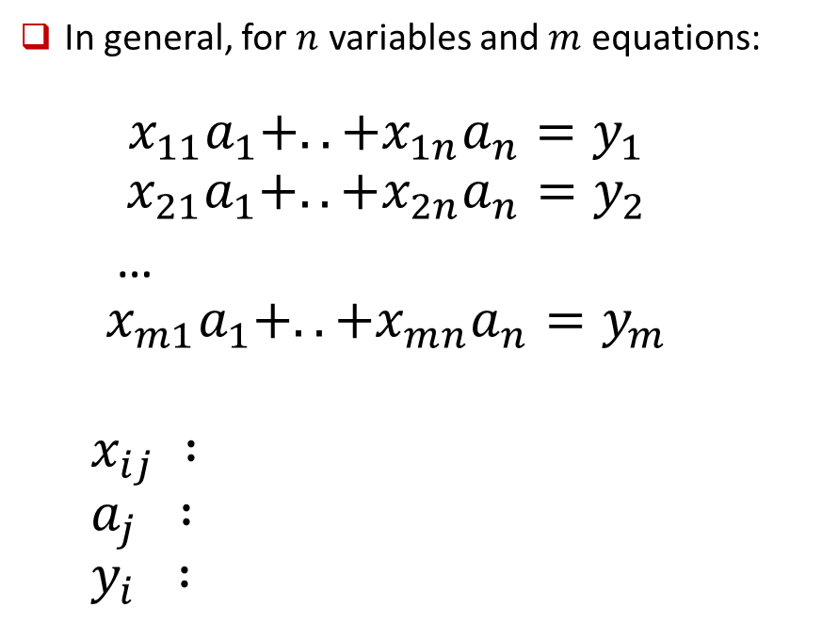
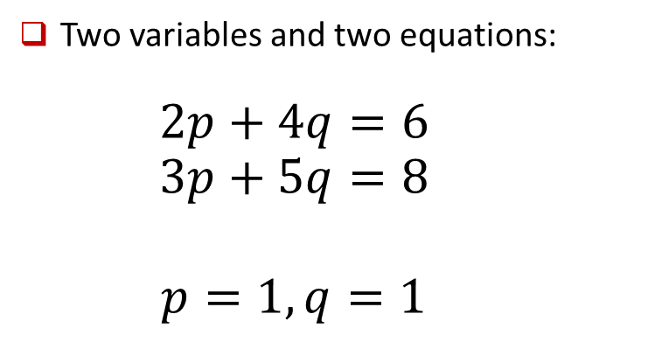
Linear regression
March 16 2016, Shangri La, New Delhi
In general, for $n$ variables and $m$ equations:
$$x_{11}a_{1}+..+x_{1n}a_{n}=y_{1}$$
$$x_{21}a_{1}+..+x_{2n}a_{n}=y_{2}$$
…
$$x_{m1}a_{1}+..+x_{mn}a_{n}=y_{m}$$
$$x_{ij} :$$
$$a_{j} :$$
$$y_{i} :$$
Two variables and two equations:
$$2p+4q=6$$
$$3p+5q=8$$
$$p=1, q=1$$
Values we know
Constants we do not know
Values we want the constants to multiply and produce
Notes:
Change title and authors

Slide 37
March 16 2016, Shangri La, New Delhi
Known Inputs
Unseen Inputs
1
Build an ML predictor
3
2
Expected output
Predicted output
This optimizes a fitness function
Notes:
Change title and authors

Slide 38
March 16 2016, Shangri La, New Delhi
Building linear regression models
CHECKPOINT #5
Notes:
Change title and authors

Slide 39
Linear regression
March 16 2016, Shangri La, New Delhi
How good is your model?
Notes:
Change title and authors

Slide 40
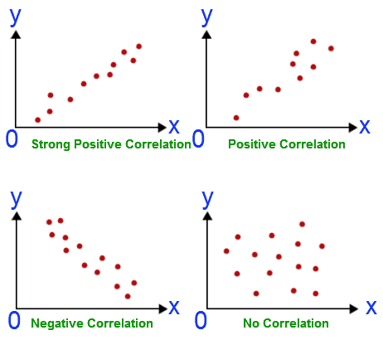
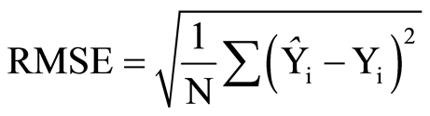
Error metrics
March 16 2016, Shangri La, New Delhi
Correlation
.
Notes:
Change title and authors

Slide 41
March 16 2016, Shangri La, New Delhi
Error metrics
CHECKPOINT #6
Notes:
Change title and authors

Slide 42
Decision Trees
March 16 2016, Shangri La, New Delhi
Leave At
If we leave at 10 AM and there are no cars stalled on the road, what will our commute time be?
10 AM
9 AM
8 AM
Stall?
Accident?
No
Yes
Long
No
Yes
Short
Long
Medium
Long
research.aspiringminds.com
Notes:
here you can give this slide as a reference - http://www.autonlab.org/tutorials/overfit10.pdf

Slide 43
Complicated Decision Tree: Whether the kids will Play (P) outside or Not (N)
March 16 2016, Shangri La, New Delhi
Temperature
hot
cold
moderate
Outlook
Outlook
Windy
sunny
rainy
sunny
rainy
yes
no
overcast
overcast
P
P
Windy
Windy
P
Humidity
N
Humidity
yes
no
yes
no
high
normal
high
N
P
P
N
Windy
P
Outlook
P
yes
no
sunny
rainy
overcast
N
P
N
P
null
research.aspiringminds.com
Notes:
here you can give this slide as a reference - http://www.autonlab.org/tutorials/overfit10.pdf

Slide 44
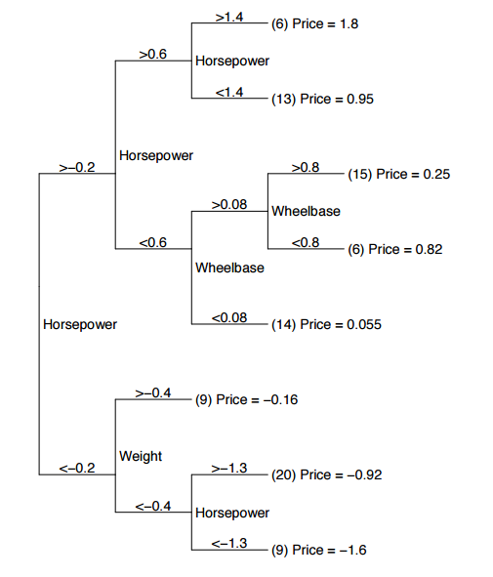
Regression Tree: Predict the price of car according to their specifications.
March 16 2016, Shangri La, New Delhi
research.aspiringminds.com
Notes:
here you can give this slide as a reference - http://www.autonlab.org/tutorials/overfit10.pdf

Slide 45
Decision Trees
March 16 2016, Shangri La, New Delhi
A predictive model based on a branching of series of Boolean tests
These smaller Boolean tests are less complex than a one-stage classifier
Idea behind any decision tree algorithm is as follows:
Choose the best attribute(s) to split the remaining instances and make that attribute a decision node
Repeat this process for recursively for each child
Stop when:
All the instances have the same target attribute value
There are no more attributes
There are no more instances
research.aspiringminds.com
Notes:
here you can give this slide as a reference - http://www.autonlab.org/tutorials/overfit10.pdf

Slide 46
March 16 2016, Shangri La, New Delhi
Decision Trees
CHECKPOINT #7
Notes:
Change title and authors

Slide 47
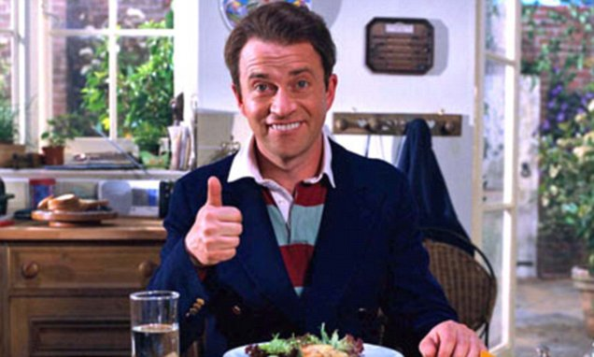
Decision trees
March 16 2016, Shangri La, New Delhi
Your models seem to be performing exceptionally well!
Notes:
Change title and authors

Slide 48
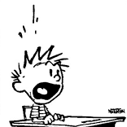
Decision trees
March 16 2016, Shangri La, New Delhi
Your models seem to be performing exceptionally well!
Then something must be wrong
Notes:
Change title and authors

Slide 49
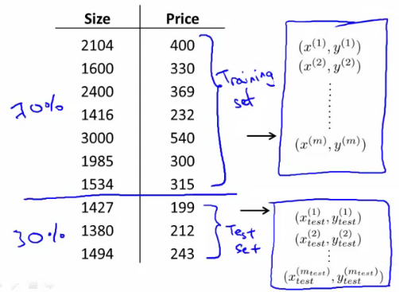
Train and Test sets
March 16 2016, Shangri La, New Delhi
Notes:
Change title and authors

Slide 50
Linear regression
March 16 2016, Shangri La, New Delhi
Now how do your models perform?
Notes:
Change title and authors

Slide 51
March 16 2016, Shangri La, New Delhi
Train-test sets
CHECKPOINT #8
Team | Correlation on test
Notes:
Change title and authors

Slide 52
March 16 2016, Shangri La, New Delhi
What happened with linear regression there? Why didn’t it behave badly on train?
Notes:
Change title and authors

Slide 53
March 16 2016, Shangri La, New Delhi
Let’s try out ML different techniques
CHECKPOINT #9
Notes:
Change title and authors

Slide 54
March 16 2016, Shangri La, New Delhi
Algorithm | Problem Type | Results interpretable by you? | Average predictive accuracy | Training speed | Prediction speed | Amount of parameter tuning needed (excluding feature selection) | Performs well with small number of observations? | Handles lots of irrelevant features well (separates signal from noise)?
KNN | Either | Yes | Lower | Fast | Depends on n | Minimal | No | No
Linear regression | Regression | Yes | Lower | Fast | Fast | None (excluding regularization) | Yes | No
Logistic regression | Classification | Somewhat | Lower | Fast | Fast | None (excluding regularization) | Yes | No
Naive Bayes | Classification | Somewhat | Lower | Fast (excluding feature extraction) | Fast | Some for feature extraction | Yes | Yes
Decision trees | Either | Somewhat | Lower | Fast | Fast | Some | No | No
Random Forests | Either | A little | Higher | Slow | Moderate | Some | No | Yes (unless noise ratio is very high)
AdaBoost | Either | A little | Higher | Slow | Fast | Some | No | Yes
Neural networks | Either | No | Higher | Slow | Fast | Lots | No | Yes
Notes:
Change title and authors

Slide 55
Session 3
March 16 2016, Shangri La, New Delhi
Improving your model
Notes:
Change title and authors

Slide 56
Overfitting
March 16 2016, Shangri La, New Delhi
research.aspiringminds.com

Slide 57
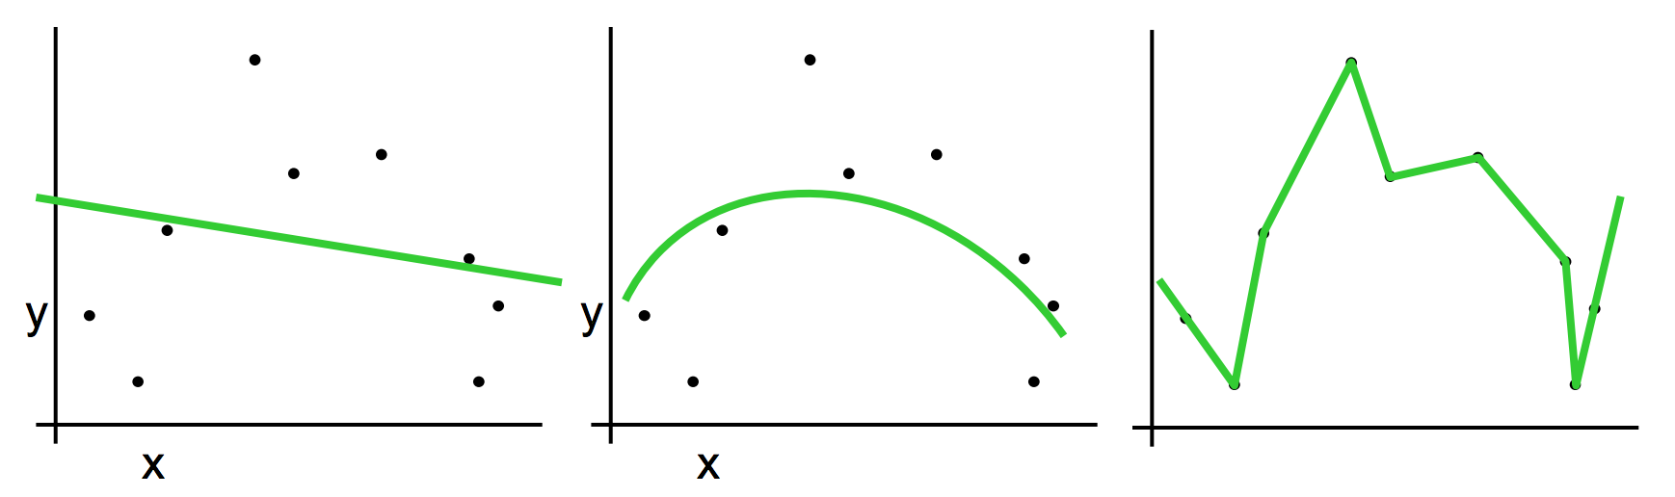
Which is the best model?
March 16 2016, Shangri La, New Delhi
research.aspiringminds.com

Slide 58
Which is the best model?
March 16 2016, Shangri La, New Delhi
Has the best fit on the training data (lowest error) so it should be this one?
research.aspiringminds.com

Slide 59


Which is the best model?
March 16 2016, Shangri La, New Delhi
Want to use a generalizable model that best predicts new, unseen data
Has the best fit on the training data (lowest error) so it should be this one? Model C is overfitting the data
research.aspiringminds.com

Slide 60
Which is the best model?
March 16 2016, Shangri La, New Delhi
A
B
C
Want to use a generalizable model that best predicts new, unseen data
Has the best fit on the training data (lowest error) so it should be this one? Model C is overfitting the data
research.aspiringminds.com

Slide 61
How to detect overfitting in your model?
March 16 2016, Shangri La, New Delhi
If a model’s accuracy over the training set increases but decreases or stays the same over the test* set, it is an indicator of overfitting
*Is it the test set?
research.aspiringminds.com

Slide 62
How do you fix overtraining?
March 16 2016, Shangri La, New Delhi
Regularization
Select important features using feature selection techniques
research.aspiringminds.com
Notes:
here you can give this slide as a reference - http://www.autonlab.org/tutorials/overfit10.pdf

Slide 63



Regularization in Decision trees
March 16 2016, Shangri La, New Delhi
Let’s say that there is a decision tree with N nodes.
The fitness function is given by:
If we account for the complexity of the model, which can be given by λ * N
The final fitness function becomes:
research.aspiringminds.com
Notes:
Just a fun implementation of Decision trees

Slide 64
Regularization
March 16 2016, Shangri La, New Delhi
But what should be the values of λ and N?
research.aspiringminds.com
Notes:
Just a fun implementation of Decision trees

Slide 65
Regularization
March 16 2016, Shangri La, New Delhi
But what should be the values of λ and N?
We can vary the values of λ and N and build models for each set.
Now we can check the performance of each model on the test set.
The [λ and N] model with the least test error can be considered as the most optimal model amongst these models.
But now I’ve seen the test set, isn’t that wrong?
research.aspiringminds.com
Notes:
Just a fun implementation of Decision trees

Slide 66
Cross-validation
March 16 2016, Shangri La, New Delhi
Yes, which is why we decide these hyper-parameters on the validation sets, which are made from the test set.
This is known as cross-validation.
There are different techniques of cross-validating and tuning hyperparameters such as:
K-fold
Leave-one-out
Leave-p-out
research.aspiringminds.com
Notes:
Just a fun implementation of Decision trees

Slide 67
Regularization and Cross-validation
March 16 2016, Shangri La, New Delhi
Want to minimize model complexity since simpler models generalize better
The idea is to penalize more complex models and reduce the weights of the model to create a simpler and more effective model.
CHECKPOINT #10
research.aspiringminds.com
Notes:
here you can give this slide as a reference - http://www.autonlab.org/tutorials/overfit10.pdf

Slide 68
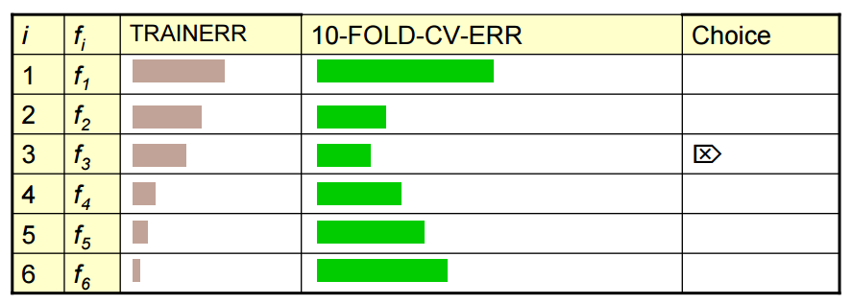
Quiz time
March 16 2016, Shangri La, New Delhi
Let’s say we have built different models f1 to f6, with train and 10-fold cross validation error shown as TRAINERR and 10-FOLD-CV-ERR below.
What do you think which model should we choose?
research.aspiringminds.com
Notes:
Just a fun implementation of Decision trees

Slide 69
Quiz time
March 16 2016, Shangri La, New Delhi
It would be f3 and not f6 because though the train error is constantly decreasing.
But the model become more complex and less generalized.
research.aspiringminds.com
Notes:
Just a fun implementation of Decision trees

Slide 70
Feature selection
March 16 2016, Shangri La, New Delhi
research.aspiringminds.com

Slide 71
Final model building
March 16 2016, Shangri La, New Delhi
research.aspiringminds.com
Notes:
here you can give this slide as a reference - http://www.autonlab.org/tutorials/overfit10.pdf

Slide 72
Submit your models on leaderboard.aspiringminds.in
March 16 2016, Shangri La, New Delhi
research.aspiringminds.com
Notes:
here you can give this slide as a reference - http://www.autonlab.org/tutorials/overfit10.pdf

Slide 73
March 16 2016, Shangri La, New Delhi
research.aspiringminds.com
Notes:
here you can give this slide as a reference - http://www.autonlab.org/tutorials/overfit10.pdf

Slide 74
March 16 2016, Shangri La, New Delhi
research.aspiringminds.com
Notes:
here you can give this slide as a reference - http://www.autonlab.org/tutorials/overfit10.pdf

Slide 75
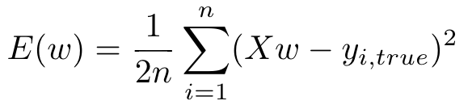

Regularization
March 16 2016, Shangri La, New Delhi
The Mean Squared Error of the model is calculated using the following equation:
research.aspiringminds.com
Notes:
here you can give this slide as a reference - http://www.autonlab.org/tutorials/overfit10.pdf

Slide 76
Regularization
March 16 2016, Shangri La, New Delhi
We want to reduce the inflated weights of parameters because smaller weights result in simpler models
To accomplish this, we add an extra penalization term to the MSE equation that incorporates the model complexity into the error-value
research.aspiringminds.com
Notes:
here you can give this slide as a reference - http://www.autonlab.org/tutorials/overfit10.pdf

Slide 77
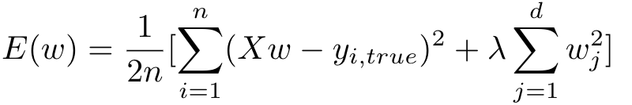
Regularization
March 16 2016, Shangri La, New Delhi
regularization parameter
n: # of training examples
d: # of parameters
research.aspiringminds.com
Notes:
here you can give this slide as a reference - http://www.autonlab.org/tutorials/overfit10.pdf

Slide 78
Regularization
March 16 2016, Shangri La, New Delhi
Having a penalization term for higher weights prevents the model from accounting for small perturbations in the data and thus making it less-prone to overfitting
λ is a hyperparameter, known as the regularization parameter, that tries to achieve a balance between trying to fit the training data accurately as well as keeping the parameter weights small to avoid overfitting
research.aspiringminds.com
Notes:
here you can give this slide as a reference - http://www.autonlab.org/tutorials/overfit10.pdf

Slide 79
Regularization
March 16 2016, Shangri La, New Delhi
How to determine the hyperparameters (λ, for example)?
research.aspiringminds.com
Notes:
here you can give this slide as a reference - http://www.autonlab.org/tutorials/overfit10.pdf

Slide 80
Through cross validation
March 16 2016, Shangri La, New Delhi
Need to define a range of values from which λ will be selected. This is because it is not normally feasible to test every possible value of λ
Randomly shuffle data and then split into training and validation sets with 70% of the data in the training set and 30% in validation set.
For each λ-value, repeat the above step 10x times
We want to pick the λ-value with the smallest averaged error value
research.aspiringminds.com
Notes:
here you can give this slide as a reference - http://www.autonlab.org/tutorials/overfit10.pdf

Slide 81
Through cross validation
March 16 2016, Shangri La, New Delhi
Let’s try it out!
research.aspiringminds.com
Notes:
here you can give this slide as a reference - http://www.autonlab.org/tutorials/overfit10.pdf

Slide 83
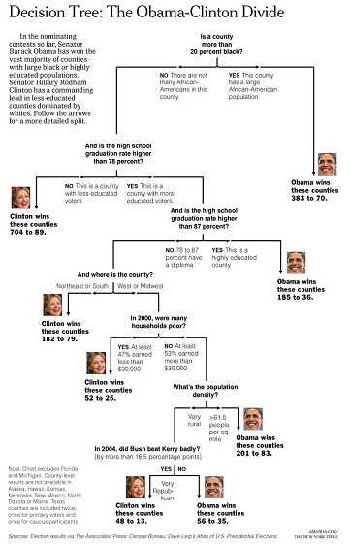
March 16 2016, Shangri La, New Delhi
research.aspiringminds.com
Notes:
Just a fun implementation of Decision trees

